Slide 1
Unix domain sockets
Session 07
Course : COMP6584001 – Network and Systems Programming
Ivan Sebastian Edbert

Slide 2
Learning Objectives
At the end of this session, the student will be expected to :
Understand Unix Domain Socket
Binding Unix Domain Socket
Writing a Service That Authenticates Clients

Slide 3
Outline
Unix Domain Socket
Binding to Unix Domain Socket Files
Writing a Service That Authenticates Clients

Slide 4
Unix domain socket

Slide 5
Unix domain socket
A Unix Domain Socket (UDS) is a communication mechanism that allows inter-process communication (IPC) between processes on the same Unix or Unix-like system.
Unlike traditional network sockets, Unix Domain Sockets operate entirely within the operating system's kernel and do not use the network stack, making them more efficient for communication between processes on the same machine.
Unix domain sockets apply the socket-addressing principle to the file- system: each Unix domain socket has an associated file on the filesystem, which corresponds to a network socket’s IP address and port number.
You can communicate with a service listening to the socket by reading from and writing to this file.

Slide 6
Unix domain socket
Key features
Path-Based: Unix Domain Sockets are identified by a file system path rather than an IP address and port number, as is the case with network sockets. The socket is created as a special file on the file system.
Efficiency: Because Unix Domain Sockets operate within the kernel and do not involve network stack overhead, they are generally faster and have lower latency compared to network sockets for communication between processes on the same machine.
Local Communication: UDS is suitable for communication between processes running on the same host. It provides a way for processes to exchange data without the need for network protocols.

Slide 7
Unix domain socket
Key features
Two Types: There are two types of Unix Domain Sockets: stream sockets and datagram sockets.
Stream Sockets: Provide a reliable, connection-oriented communication similar to TCP. They guarantee data integrity and order.
Datagram Sockets: Offer connectionless, unreliable communication similar to UDP. They are useful when the order of messages is not critical.
File System Cleanup: When processes using Unix Domain Sockets terminate, the associated socket file is automatically removed by the operating system. This eliminates the need for manual cleanup.
File Permissions: Permissions for accessing a Unix Domain Socket are determined by the file system permissions of the socket file.

Slide 8
Binding unix to socket file

Slide 9
Binding unix to socket file
A Unix domain socket file is created when your code attempts to bind to an unused Unix domain socket address by using the net.Listen, net.ListenUnix, or net.ListenPacket functions.
If the socket file for that address already exists, the operating system will return an error indicating that the address is in use. In most cases, simply removing the existing Unix domain socket file is enough to clear up the error.
However, you should first make sure that the socket file exists not because a process is currently using that address but because you didn’t properly clean up the file from a defunct process.
If you wish to reuse a socket file, use the net package’s FileListener func- tion to bind to an existing socket file. This function is beyond the scope of this book, but I encourage you to read its documentation.

Slide 10
Unix domain socket type
There are three types of Unix domain sockets: streaming sockets, which operate like TCP; datagram sockets, which operate like UDP; and sequence packet sockets, which combine elements of both.
Go designates these types as unix, unixgram, and unixpacket, respectively. In this section, we’ll write echo servers that work with each of these types.
The net.Conn interface allows you to write code once and use it across multiple network types.
It abstracts many of the differences between the net- work sockets used by TCP and UDP and Unix domain sockets, which means that you can take code written for communication over TCP, for example, and use it over a Unix domain socket by simply changing the address and network type.

Slide 11
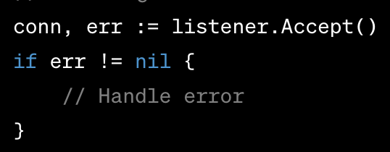
Unix domain socket type
The unix Streaming Socket
Unix Stream Sockets:
Type: Connection-oriented, reliable.
Characteristics: Similar to TCP sockets in a network.
Behavior: Provides a reliable, two-way communication channel. Data is transmitted in a stream, and the order is preserved.

Slide 12
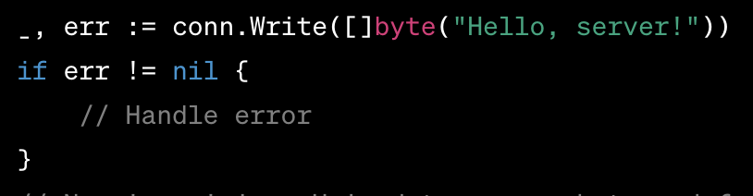
Unix domain socket type
Unix datagrams socket
Unix Datagrams Sockets:
Type: Connectionless, unreliable.
Characteristics: Similar to UDP sockets in a network.
Behavior: Provides a connectionless communication channel. Each message is independent, and the order is not guaranteed.

Slide 13
Unix domain socket type
unixpacket Sequence Packet Socket
The sequence packet socket type is a hybrid that combines the session-oriented connections and reliability of TCP with the clearly delineated datagrams of UDP.
However, sequence packet sockets discard unrequested data in each datagram. If you read 32 bytes of a 50-byte datagram, for example, the operating system discards the 18 unrequested bytes.
Of the three Unix domain socket types, unixpacket enjoys the least cross- platform support. Coupled with unixpacket’s hybrid behavior and discarding of unrequested data, unix or unixgram are better suited for most applications. You are unlikely to find sequence packet sockets in use over the internet.
It was largely used in old X.25 telecommunication networks, some types of financial transactions, and AX.25 used in amateur radio.

Slide 14
Writing a Service That Authenticates Clients

Slide 15
Writing a Service That Authenticates Clients
On Linux systems, Unix domain sockets allow you to glean details about the process on the other end of a socket—your peer—by receiving the cre- dentials from your peer’s operating system.
You can use this information to authenticate your peer on the other side of the Unix domain socket and deny access if the peer’s credentials don’t meet your criteria.
For instance, if the user davefromaccounting connects to your administrative service through a Unix domain socket, the peer credentials might indicate that you should deny access; Dave should be crunching numbers, not sending bits to your administrative service.

Slide 16
Writing a Service That Authenticates Clients
You can create a service that allows connections only from specific users or any user in a specific group found in the /etc/groups file.
Each named group in the /etc/groups file has a corresponding group ID number.
When a client connects to your Unix domain socket, you can request the peer credentials and compare the client’s group ID in the peer credentials to the group ID of any allowed groups.
If the client’s group ID matches one of the allowed group IDs, you can consider the client authenticated. Go’s standard library has use- ful support for working with Linux groups, which you’ll use in “Writing the Service” on page 156.

Slide 17
references
Adam Woodbeck - Network Programming with Go_ Learn to Code Secure and Reliable Network Services from Scratch-No Starch Press (2021).
https://www.ibm.com/docs/en/ztpf/1.1.0.15?topic=considerations-unix-domain-sockets

Slide 18
Thankyou

